Slide 1

Computer Networking CCNA 200-301

Slide 2
Course Outline
Module 1 Network Fundamentals
Explain Role and Function of Network Components : Routers, Switches, Firewall, IPs, WLC, AP, Endpoints, Servers
OSI Reference Model and TCP/ IP Model
IPv4 Addressing and Subnetting
IPv6 Addressing and IPv6 address Types
Module 2 Basic Configuration of Router and Lan Switching
Modes of Router
Basic Security of Router (Passwords) and Configuration of IP on Router
Point to Point connectivity of Routers
Configure and Verify Layer2 Discovery Protocols (CDP and LLDP)
Basic Operation of Switch (Collision Domain and Broadcast Domain)
Spanning-tree Protocol (PVST, RSTP), Port states and Port fast
Configure and Verify VLANS and Inter-switch Connectivity (Trunk ports, 802.Iq)
Ether-channel
Cisco Wireless Architecture and AP modes
Configuration of Wireless Lan Controller and AP Using GUI (WPA, WPA2, PSK)

Slide 3
Course Outline
Module 3 IP Routing
Static Routing with IPv4 and IPv6, floating static route and Default route
Configure and Verify Single area OSPF
DR and BDR election. Point to point, Concept of Router-ID
Module 4 IP Services
NAT
Configure and Verify NTP
Describe DNS, SNMP, Syslog, QOS, Function of FTP and TFPF in network
Configuration of DHCP, telnet and SSH
Describe the function of First hop redundancy protocol (HSRP, VRRP, GLBP)

Slide 4
Course Outline
Module 5 Security Fundamentals
Configure and Verify Access control List
Describe VPN Technologies (Site-to-site VPN and Remote access VPN)
Describe Authentication, Authorization and Accounting (AAA)
Configure Port Security, DHCP Snooping and Dynamic ARP Inspection
Module 6 Automation and Programmability
Explain how automation impacts network management
Compare traditional network with controller-based networking
Compare traditional campus device management with Cisco DNA Center enabled device Management.

Slide 5
Module 6 Automation and Programmability
Explain how automation impacts network management
Compare traditional network with controller-based networking
Compare traditional campus device management with Cisco DNA Center enabled device Management.

Slide 6

How Automation Impacts Network Management
Making it easier to set up and run internet systems in today’s world.

Slide 7

The Growing Complexity of Modern Networks
Multi-Environment Networks
Manual Operations Crisis
Today’s networks connect many things , like cloud computers, smart devices, and virtual systems. which makes them very hard to manage..
People still make most network changes by hand (about 95%), which causes mistakes and slows things down.
Automation is a must
Automation is now very important because networks are growing fast and businesses keep changing.

Slide 8

What Is Network Automation?
Definition & Scope
Network automation uses software and scripts to automatically configure, manage, monitor, and troubleshoot network devices without human intervention.
Automation: Using technology to complete tasks faster and more efficiently, reducing manual effort and time.
Key automation platforms: Tools like Cisco DNA Center, Ansible, Puppet, Chef, and Python help make work faster and easier on things like routers, switches, and firewalls.
Automation replaces repetitive manual tasks with centralized, consistent, and error-free processes even in big company networks.

Slide 9

"The transformation from manual network management to automated operations represents one of the most significant shifts in IT infrastructure history."

Slide 10
Key Benefits of Network Automation
Cost Reduction
Enhanced Reliability
Dramatically reduces operational expenses by minimizing manual labor requirements and eliminating costly human errors that can cause network outages.
Increases network uptime and stability by removing human mistakes from critical configuration and maintenance processes.
Accelerated Deployment
Superior Control
Speeds up project completion with remote, simultaneous device configuration across multiple locations and network segments.
Enhances network visibility and control with real-time monitoring, consistent policy enforcement, and centralized management capabilities.

Slide 11



Real-World Impact: Automation Adoption Stats
85%
53%
40%
Tool Adoption
Configuration Automation
Policy Management
Companies using at least one network automation tool (Kentik Survey, 2019)
Organizations implementing automated configuration management
Companies using automated policy management systems

Slide 12



Automation in Action: Fault Detection & Remediation
Instant Detection
Automated monitoring systems continuously scan network infrastructure, detecting anomalies and issues in real-time with millisecond precision.
Intelligent Diagnosis
AI-powered analytics immediately analyze root causes, comparing patterns against historical data to pinpoint exact failure sources.
Automated Remediation
Self-healing systems execute predefined remediation policies, such as automatically restarting offline switches or rerouting traffic through alternative paths.

Slide 13

The Changing Role of Network Engineers
From Manual to Strategic
Network engineers no longer set up each device by hand. Now they create smart systems that can do the work automatically.
They focus on new ideas, better security, and making sure the network helps the business grow.
Essential New Skills:
Python and PowerShell scripting
AI-driven network analytics
Intent-based networking design
Cloud-native network architectures

Slide 14

The Future: AI and Intent-Based Networking
1
Predictive AI
AI-powered automation predicts network issues before they occur, optimizing performance through machine learning algorithms.
2
Intent-Based Networks
Networks that use business goals and policies to dynamically adjust behavior, automatically adapting to changing requirements.
3
2026 Outlook
Over 80% of enterprises expected to deploy AI-enhanced network automation solutions (Gartner forecast).

Slide 15







Conclusion: Automation is the Future of Network Management
Process Transformation
Business Empowerment
Automation revolutionizes network management into a faster, more reliable, and cost-effective operation model.
Organizations embracing automation, gain the ability to scale securely while driving continuous innovation.
Career Evolution
Network engineers unlock new opportunities in our increasingly digital-first business landscape.

Slide 16

Comparing Traditional Networking with Controller-Based Networking
Understanding the evolution from device-centric to centralized network management

Slide 17

Traditional Networking: Device-by-Device Management
Individual Configuration
Manual CLI Commands
Each network device (router, switch) is configured and managed individually through separate interfaces.
Manual configuration via command-line interface for every device increases time and risk of human errors.
Repetitive Tasks
Updating IOS on 10 routers requires 30 manual steps repeated per device - multiplying effort and complexity.

Slide 18

Controller-Based Networking: Centralized Automation
Centralized Management
Automated Operations
Uses a centralized controller to manage and configure multiple devices simultaneously from a single interface.
Automates complex tasks like initial device setup, IOS upgrades, and network troubleshooting across the infrastructure.
Reduced Staffing
Significantly reduces need for multiple administrators; one or two skilled professionals can manage entire enterprise networks.

Slide 19
Control Plane Architecture: Distributed vs Centralized
Traditional Architecture
Control plane functions (routing decisions) are distributed across individual devices, creating complexity in coordination.
Controller-Based Architecture
Control plane centralized in software controller, while data plane remains on devices for optimal performance.
Centralization enables consistent policy enforcement and faster network-wide changes across the entire infrastructure.

Slide 20
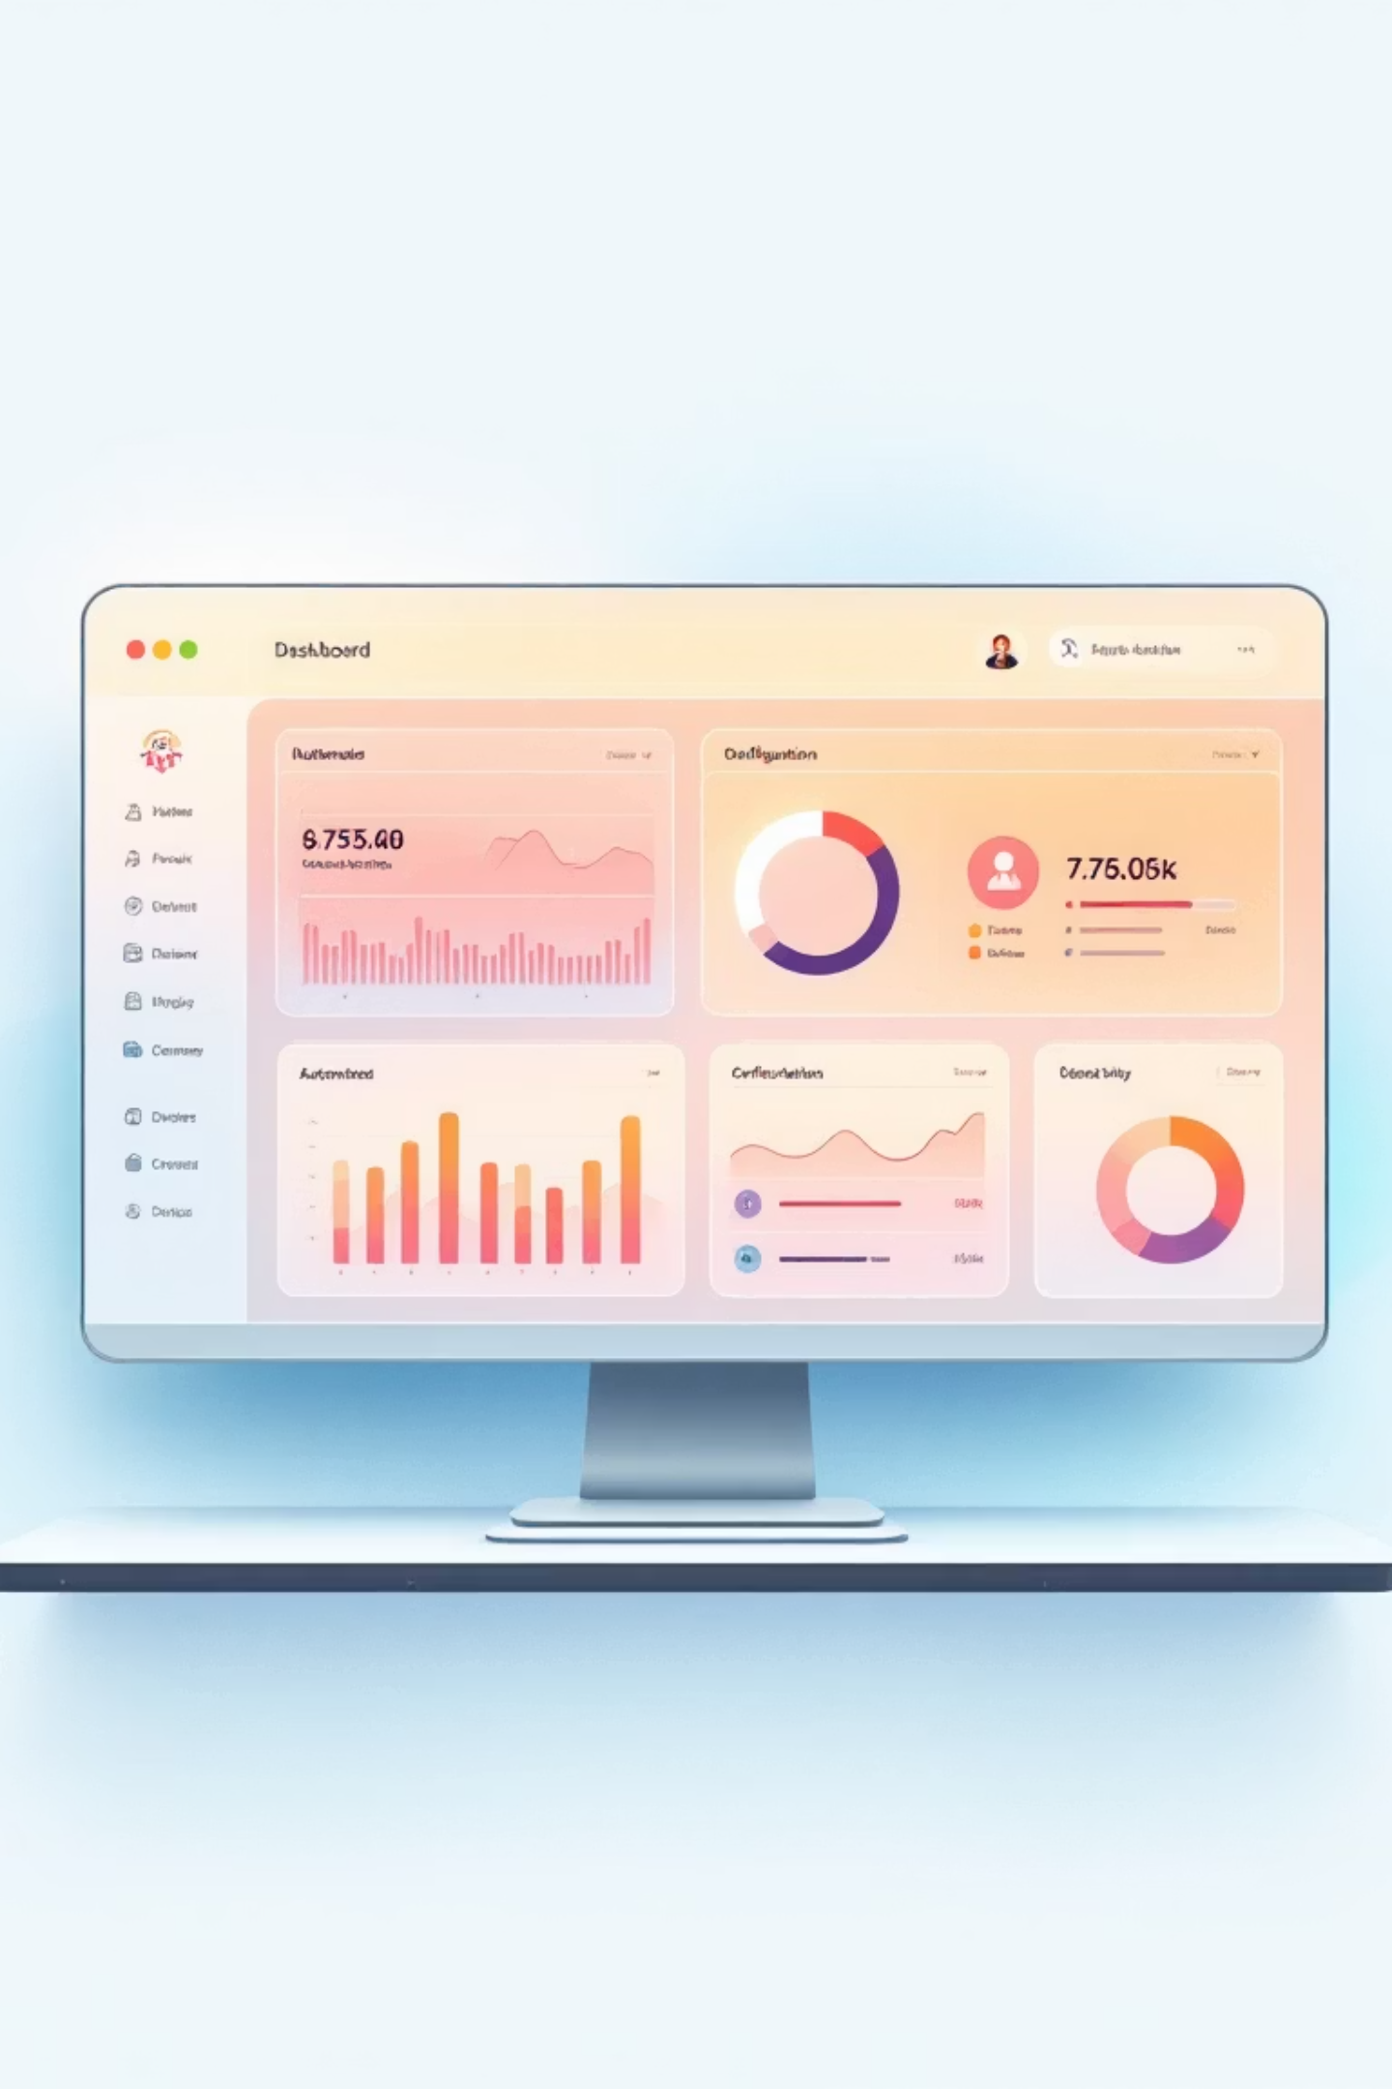



Operational Efficiency and Error Reduction
Traditional Method
Networks require logging into each device individually via console, Telnet, or SSH connections.
Controller-Based Method
Networks push configurations automatically, minimizing human error and standardizing deployments.
Proactive Management
Automation enables scheduled tasks and proactive troubleshooting without manual intervention or downtime.

Slide 21

Scalability and Flexibility
Traditional Limitations
SDN
Networks depend on special company-made hardware, which makes it hard to grow or adjust when business needs change.
(Software-Defined Networking) Principles
Controller-based networks uses software-defined networking principles for flexibility and vendor independence.
Network Virtualization
SDN(Software-Defined Networking) turns the network into software, so data can move easily and new services can be set up quickly when needed.

Slide 22
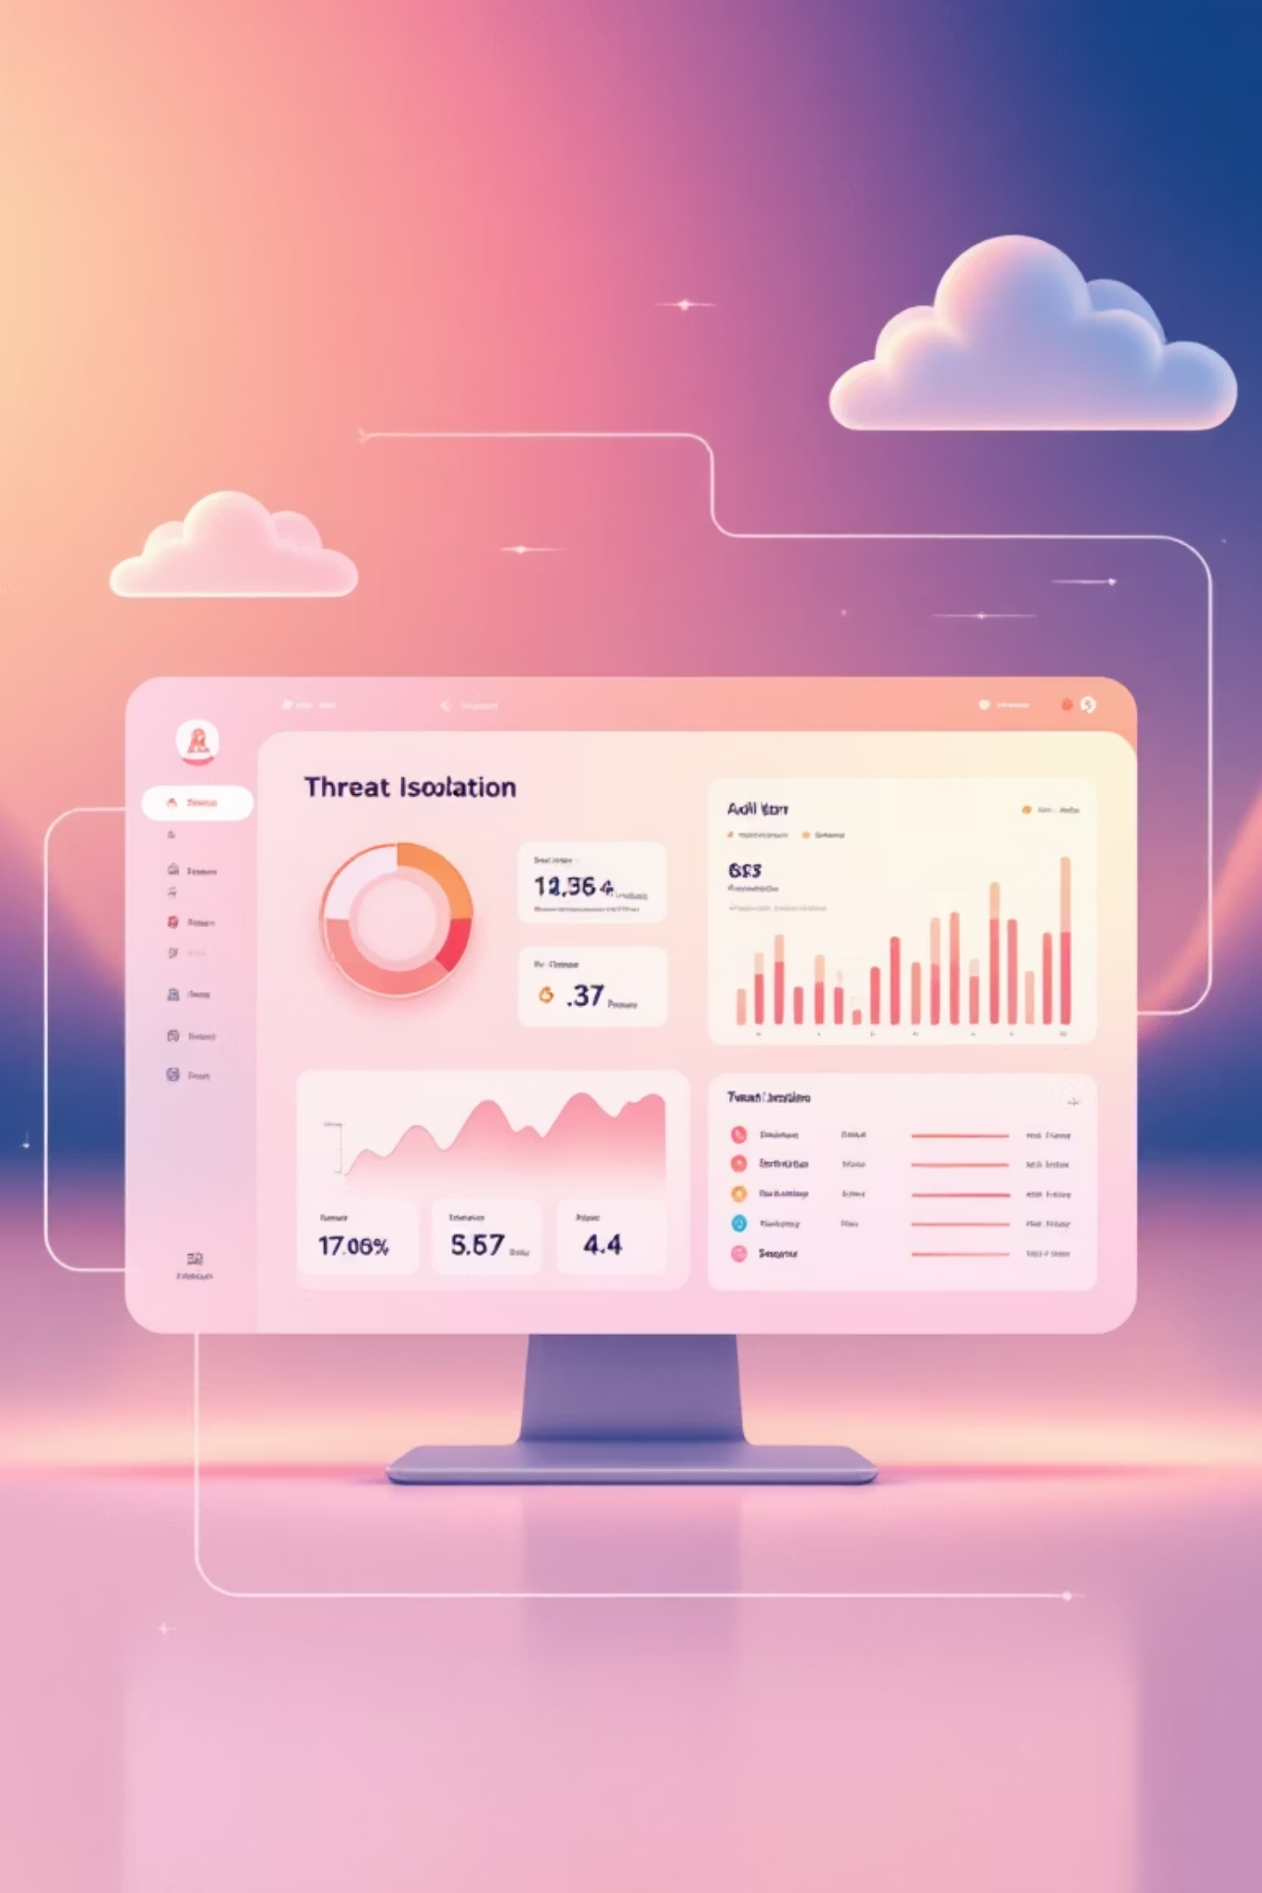
Security Models: Blacklisting vs Policy-Driven
Traditional Security
Policy-Driven Security
Networks often use blacklisting approaches (allow all traffic unless specifically blocked), creating security vulnerabilities.
Controller-based networks let you control everything from one place and apply the same security rules everywhere.
Dynamic Response
They can quickly stop security threats and make sure important business data moves first across the whole network.

Slide 23

Real-World Impact: Cost and Resource Savings
75%
90%
60%
Reduced Labor Costs
Faster Deployments
Time Savings
Automated IOS upgrades save hours per device, scaling efficiently across large enterprise networks.
Traditional networks require high operational costs due to manual labor and error correction efforts.
Controller-based networks need fewer administrators; automation significantly reduces downtime and maintenance windows.

Slide 24

Comparing Traditional Campus Device Management with Cisco DNA (Digital Network Architecture) Center
A comprehensive analysis of how Cisco DNA Center transforms campus network management from manual complexity to intelligent automation

Slide 25

Traditional Campus Device Management: Manual and Fragmented
Manual Configuration
Device Discovery
Network admins configure devices individually via CLI using Telnet or SSH connections
Topology mapping done manually or semi-automatically, requiring constant oversight
Work that easily causes mistakes.
Complex Security
Troubleshooting and updates require manual intervention, making networks vulnerable to human error
Security policies managed via complex ACLs that are difficult to scale and maintain effectively

Slide 26




Automation vs Manual Configuration
Traditional Approach
Each device configured separately through time-consuming, error-prone manual processes
DNA Center Solution
Automated deployment of QoS, security policies, and updates across entire network infrastructure
EasyQoS Feature
Simplifies complex Quality of Service setup with intuitive few-click configuration
Measurable Results
Faster deployments, significantly reduced operational costs, and fewer costly human errors

Slide 27
Enhanced Security with Cisco DNA Center
Traditional Security Limitations
Reactive security approach with complex, static ACLs vulnerable to misconfigurations and security gaps.
Dynamic Policy Enforcement
Intelligent security policies based on user and device roles, enforced dynamically at the network edge.
DNA Center Security Innovation
Integrated multi-tier segmentation using VRFs and Scalable Group Tags (SGTs) for comprehensive protection.
Advanced Threat Detection
Encrypted traffic analysis capabilities detect sophisticated threats even within encrypted data flows.

Slide 28

Real-World Impact: Cost and Risk Reduction
60%
75%
90%
Cost Reduction
Faster Deployment
Risk Mitigation
Lower operational expenses through reduced manual tasks and automated processes
Significant reduction in misconfiguration risks and unplanned downtime incidents
Accelerated service deployment that aligns network capabilities with dynamic business requirements
Manual operations significantly increase the risk of costly misconfigurations and extended downtime periods. Cisco DNA Center creates a future-proof network infrastructure ready for evolving technologies and emerging security threats.

Slide 29
Explain how automation impacts network management
Traditional Network (Manual Way) Example:
Let’s say you have:
5 routers
10 switches
50 computers
If you want to change something (like update a password, IP, or security rule):
You must log in to each router and switch one by one.
You type commands manually for each device.
It can take hours or even days, and if you make a small mistake, the network may stop working.
Automated Network (With Cisco DNA Center) Example :
With Cisco DNA Center, you control everything from one dashboard.
You create a rule or setting once (for example: “set this security policy for all devices”).
DNA Center automatically sends that setting to all routers and switches.
It also checks for problems, fixes small issues, and shows reports on network health.

Slide 30
Explain how automation impacts network management
What is Network Automation?
It’s the use of technology to automatically configure, manage, and monitor network devices like routers and switches.
It reduces manual work and helps manage large networks more efficiently.
Automatically sets up and configures devices.
Saves time and effort, as tasks are done faster.
Automatically detects issues like network failures or slow speeds.
Quickly alerts administrators, so problems are fixed faster.
Automation ensures all devices are set up the same way.
Less risk of human error in the configuration.
New devices or network segments can be set up automatically as the network grows.
Makes it easier to expand without manual configuration.
Automatically updates devices to the latest security patches.
Ensures security rules are consistently applied across the network.
Saves money on manual labor.
Optimizes resource use and reduces unnecessary network downtime.
Speeds up the deployment of new services or network changes.
Allows the network to adapt quickly to new business needs or changes.
Faster setup, fewer mistakes, and a more reliable network.
Helps businesses save time, reduce costs, and improve security.

Slide 31
Compare traditional network with controller-based networking
Traditional Networking
Manual Configuration: Devices configured individually.
Device-Centric: Each device is managed separately.
Limited Automation: Mostly manual tasks.
Less Scalable: Difficult to manage as the network grows.
Time-Consuming: Requires more time for changes and maintenance.
Controller-Based Networking
Centralized Control: Managed through a central controller.
Automated Management: Tasks like provisioning and monitoring are automated.
Scalable: Easily grows without manual configurations.
Dynamic: Network changes are made easily through software.
Flexible: Can quickly adapt to new needs or configurations..

Slide 32
Compare traditional campus device management with Cisco DNA Center enabled device Management
Traditional Device Management
Manual Configuration: Each device is configured individually.
Device-Centric: Managed separately, no central control.
Limited Automation: Mostly manual tasks.
Time-Consuming: Hard to scale, error-prone.
No Centralized View: Fragmented monitoring and management.
Cisco DNA (Digital Network Architecture) Center Management
Centralized Control: Manage all devices from one platform.
Automated: Provisioning, updates, and monitoring are automated.
Policy-Based: Consistent policies across the network.
Real-Time Analytics: Proactive monitoring and troubleshooting.
Scalable: Easy to scale with minimal manual work.

